Slide 1
Memory Management Implementation Issues Segmentation

Slide 2
Review
Memory Manager
coordinate how the different types of memory are used
keep track memory to allocate and release areas of main memory to processes
manage swapping between main memory and disk
No Memory Abstractions
Single program
One OS, only one process
Special register is used to protection between OS and process
Disadvantages: slow
Multiple program
One OS, many processes locate in memory
Divided into fixed size block
Disadvantages
Internal fragmentations
Two programs both reference absolute physical memory → static relocation

Slide 3
Review
Memory Abstractions
Multiple processes locate in memory (both primary and secondary)
Base and Limit Registers
Multiple processes locate in memory and protection
Base contains the first address of process in memory, Limit contains the length of process, the process owns private address space
Disadvantages
External fragmentation (Defragment)
Slow
Swapping
Multiple processes with ready processes locate in memory and passive processes locate in HDD – swap file area
Swap out/ in operator
Disadvantages
External fragmentation
Process can not grow in memory and the swap area on the disk is full → data segment upward, stack segment downward

Slide 4
Review
Memory Abstractions
Memory Management with Bitmaps
The memory divides units with same size that has a bit corresponding bit in the bitmap (0: free, 1: occupied)
Disadvantages
Slow when searching the bitmap to find a run of k consecutive 0 bits in the map (small)
External fragment (large size)
Memory Management with Linked Lists
Maintain a linked list of allocated (P) and free memory (H)
Allocating algorithms
First, Next, Best, Worst, Quick Fit
Virtual Memory
Software/ Process sizes larger than memory
Overlays
Developer splits program to many overlays
Disadvantages: developer‘s knowledge is important

Slide 5
Review
Memory Abstractions
Virtual Memory
Paging
Address space is broken up into pages
Physical memory is divided up into page frames
Virtual address vs. Physical address, manage address space with bit
MMU transfers Virtual address → p, d; then it looks up page table following the index to get the page frame; the page frame combines with d to determine the physical address
Page fault: the program references a part of its address space that is not in physical memory
Page table
Load to collection registers, load to memory using base register, using TLB
Excessive large page table: multilevel page, inverted page table, inverted page table with hash or TLB
Entry: Caching disabled, Referenced, Modified, Protection, Present/absent, page frame number

Slide 6
Review
Memory Abstractions
Virtual Memory
Paging
Page replace algorithms
Optimal: the page will be the latest one accessed in the future
NRU: the page has lowest class that combines R and M bit
FIFO: the page at the head of queue
Second Chance: old page has not been not referenced in the previous clock interval (R = 0). If R of page equals 1, R is reset to 0 and put the tail of the queue.
Clock (circular queue) : the page being pointed to by the hand is inspected. If R = 0, page is evicted. Otherwise, R is reset to 0, the pointer points next
LRU: the page at the end of the list is replaced, the list must be updated at each memory reference
NFU, Aging (using bit): The page with the lowest counter
Working set model, working set clock (circular queue): Third Chance with Second Chance using age > τ with bit R
Terminology: Thrashing, Locality of Reference, Demand paging, prepaging, working set, page fault rate

Slide 7
Review
Design Issues
Local vs Global Policies
Local: page frames are static allocated among current processes (thrashing or waste memory)
Global: page frames are dynamically allocated among runnable processes (thrashing to others process)
Solution
Monitor the size of working set of all processes using aging bit
The allocation is updated dynamically using PFF algorithms with To periodically determine the number of running processes, Giving each process a minimum number of frames
Load Control
Swapping and Considering not only process size and paging rate but also its characteristics
Page Size
Optimizing the size of the page and the location of page table

Slide 8
Review
Design Issues
Separate Instruction and Data Spaces
Sharing code, library, read only memory
Copy on write
Memory Mapped File
Paging the file as process
Cleaning Policy
Using two-handed clock
Front hand is controlled by the paging daemon
Back hand is used for page replacement algorithm as in the standard clock algorithm

Slide 9
Objectives…
Implementation Issues
OS Involvement with Paging
Page Fault Handling
Instruction Backup
Locking Pages in Memory
Backing Store
Policy and Mechanism
Segmentation
Pure Segment
Segmentation with Paging: MULTICS
Segmentation with Paging: Intel Pentium

Slide 10
Implementations Issues OS Involvement in Paging
There are four time when OS has paging related work to do
Process creation time
Process execution time
Page fault time
Process terminal time

Slide 11
Implementations Issues OS Involvement in Paging
Process creation time
OS has to determine how large the program and data will be and create page table for them.
Space has to be allocated in memory for page table and it has to be initialized
The page table need not be resident when the process is swapped out but has to be in memory when the process is running.
Space has to be allocated in the swap area (that has to be initialized with program text and data) on disk so that when a page is swapped out, it has somewhere to go
Some systems page the program text directly from the executable file, thus saving disk space and initialization time
Information the page table and swap area on disk must be recorded in the process table

Slide 12
Implementations Issues OS Involvement in Paging
Process execution time
When a process is scheduled for execution, the MMU has to be reset for the new process and the TLB flushed, to get rid of traces of the previously executing process
The new process’ page table has to be made current, usually by copying it or a pointer to it to some hardware registers
Optionally, some or all of the process’ pages can be brought into memory (prepaging) to reduce the number of page faults initially

Slide 13
Implementations Issues OS Involvement in Paging
Page fault time
When a page fault occurs, the OS has to read out hardware registers to determine which virtual address causes the fault
OS must compute which page is needed and locate that page on disk, then it must find an available page frame to put the new page, evicting some old page if need be
OS read the needed page into the page frame
OS must back up PC to have it point to the faulting instruction and let that instruction execute again
Process terminal time
When a process exits, the OS must release its page table, its page, and disk space that the pages occupy when they are on disk
If some of the pages are shared with other processes, the pages in memory and on disk can only be released when the last process using them has terminated

Slide 14
Implementations Issues Page Fault Handling
The hardware trap to kernel; save PC on stack; save information about the state of current instruction into a special CPU registers
An assembly code routine is started to save the general registers and other volatile information to keep the OS from destroying it
The OS find the virtual page
The hardware registers contains this information.
If not, the OS must retrieve the PC, fetch the instruction, and parse it in software to figure out what it was doing when the fault hit
Check if the address is valid and the protection consistent with the access.
If not, the process sent a signal or killed.
If the address is valid and no protection fault has occurred, the system checks to see if a page frame is free. If no frames are free, the page replacement algorithm is run to select a victim
If the “victim” page is dirty, the page is scheduled for transfer to the disk, and a context switch take place, suspending the faulting process and letting another one run until the disk transfer has completed. In any event, the framed is marked as busy to prevent it from being used for another purpose

Slide 15
Implementations Issues Page Fault Handling
When the page frame is clean, the OS find on the disk address where the needed page is, and scheduled a disk operation to bring it in. While the page is being loaded, the faulting process is still suspended and another user process is run, if one is available
When the disk interrupt indicates that the page has arrived, the OS updates the page table and mark as normal the page frame
The faulting instruction is backed up to the state it had when it began and the PC is reset to point to that instruction
The faulting process is scheduled, and the OS returns to the routine that called it
This routine reloads the registers and other state information and returns to user space to continue execution, as if no fault had occurred

Slide 16
Implementations Issues Instruction Backup
It is easier said than done “When the page fault occurs, the OS fetch the page needed, it must restart the instruction causing the trap”
Context
Where should the PC’s position be backed up when the progressed instructions occur errors?
Where should the PC’s position be loaded when the instruction is restarted?
The value of PC at the time of the trap depends on which operand faulted and how the CPU’s microcode has been implemented
In auto-incrementing mode
First approach
The increment may be done before the memory reference
Before restarting the instruction, the OS must decrease the register
Second approach
The auto-increment may be done after the memory reference
The OS do nothing to restart the instruction
In auto-decrementing mode, a similar problems also occur

Slide 17
Implementations Issues Instruction Backup
Problem
The page fault occurs when a instruction reference the memory, the instruction can occur at the operands
To restart the instruction, the OS must determine where the first byte of instruction is
The OS cannot know the command (operator) if the fault occurs at the operand
→ The OS has to jump through hoops to figure out what happened and how to repair it (how to an operator as individual or atomicity)
Solution
A hidden internal is used to store the PC before each instruction is executed
A second register is used to store the registers auto-incremented or auto-decremented, and by how much
→ When the fault instruction is restarted, the OS can unambiguously undo all the effects of it

Slide 18
Implementations Issues Locking Pages in Memory
Problems
While the process is suspended because it is waiting for the I/O to complete, another process is run.
However, this other process gets a page fault
If the global paging algorithm is used, there is a chance that the page containing the I/O buffer will be chosen to be removed from memory
→ In the case of DMA used with I/O, the evicted page causes the problems
The transferring data will be written into either the buffer or this page
Notes: The DMA can be transfer the data without controlling of CPU
Solution
First Approach: Lock pages engaged in I/O in memory so that they will not be removed. (pinning)
If the locking pages in memory always occurs with high ratio, the bottle neck or thrashing can be occurs
Second Approach: Do all I/O to kernel buffers & copy the data to use pages later

Slide 19
Implementations Issues Backing Store
The simplest algorithm for allocating page space on disk
A special swap partition exits on the disk
This partition uses block numbers relative to the start of the partition, instead of using a normal file system
When the system is booted, the swap partition is empty and is represented in memory as a single entry giving its origin and size
When the process is started, a chunk of the partition area the size of first process is reserved and the remaining area reduced by that amount
As new processes are started, they are assigned chunks of the swap partition equal in size to their core images
As they finished, their disk space is freed
Requirements: swap area must be initialized to copy entire process image to the swap area before the process start
→ associated with each process is the disk address of its swap area, that is where on the swap partition its image is kept (that also kept in process table)

Slide 20
Implementations Issues Backing Store (Swap Area)
Problems:
Process can increase in size after starting
This occurs due to the growing of data and stack
Solution
First Approach: Reserve separate swap areas for text, data, stack and allow each of these areas to consist of more than one chunk on the disk (!?)
Second Approach:
Allocate nothing and allocate disk space for each page when it is swapped out and de-allocate it when it is swapped back in
→ processes in memory do not tie up any swap space
Disadvantage
A disk address is needed in memory to keep track of each page on disk
In each process, there must be a table stored the location of each page on disk

Slide 21
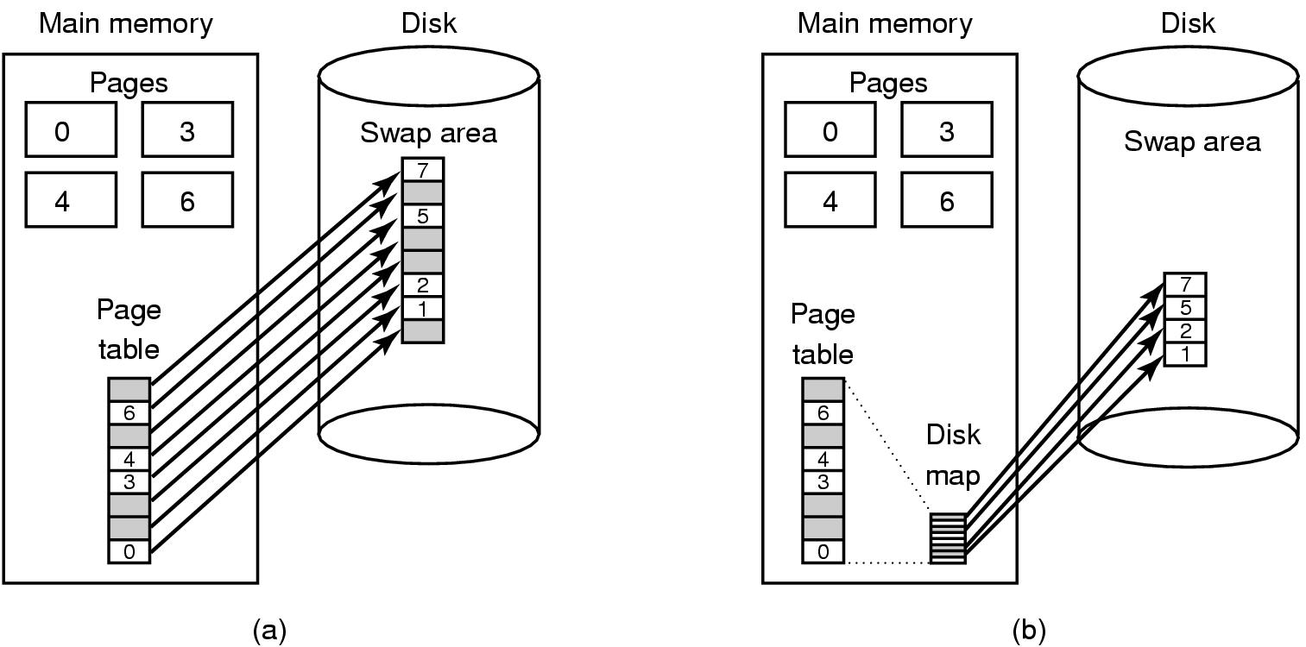
Implementations Issues Backing Store
Tanenbaum, Fig. 3-29.
(a) Paging to a static swap area. (b) Backing up pages dynamically

Slide 22
Implementations Issues Backing Store
Second approach in details,
Paging to a static swap area
The swap area on disk is as large as the process virtual address space
Each page has a fixed location on disk and store in contiguously in order of the page number
A page is in memory always has a shadow copy on disk
Disadvantages
The synchronization on disk must be progressed even the page in memory has not been modified
The page on disk may be out of date due to not update the modified page from memory (for a long time)
Ex: Unix is applied
Backing up pages dynamically
Disk map
Is a table mapping the disk address per virtual page is used
Its entries contain an invalid disk address or a bit marking them as not in used
Pages do not have fixed addresses on disk.
A page in memory has no copy on disk
When the page is swapped out, an empty disk space is chosen on the fly and the disk map is updated accordingly
Ex: Windows using swap file to apply this strategy

Slide 23
Implementations Issues Separation of Policy and Mechanism
The memory management system is divided into three parts
A low-level MMU handler
All the details of how the MMU works are encapsulated in the MMU handler
MMU handler is machine-dependent code and has to be rewritten for each new platform the OS is ported to
A page fault handler that is part of the kernel
A page fault handler is machine-independent code and contains most of the mechanism for paging
An external pager running in user space
The policy is largely determined by the external page, which runs as a user process
When a process starts up, the external page is notified in order to set up the process page map and allocate backing store on the disk if need be
As the process runs, it may map new objects into its address space, so the external pager is again notified

Slide 24
Implementations Issues Separation of Policy and Mechanism
Tanenbaum, Fig. 3-30.

Slide 25
Implementations Issues Separation of Policy and Mechanism
When the process starts running, it may get a page fault.
The fault hander figures out which virtual page is needed and send message to the external pager, telling it the problem
The external pager then reads the needed page in from the disk and copies it to a portion of its own address space, then it tells the fault handler where the page is
The fault handler then unmaps the page from the external pager’s address space and asks the MMU handler to put it into the user’s address space at the right place
The user process can be restarted
Problems
External pager does not have access to the R and M bits of all the pages
Some mechanism is needed to pass this information to the external pager or the page replacement algorithm must go in the kernel
→the fault handler tells the external pager which page it has selected for eviction and provides the data, either by mapping it into the external pager’s address space or including it in a message. Either way, the external pager writes the data to disk
Advantages: is more modular code and greater flexibility
Disadvantages: the extra overhead of the various message being sent between the pieces of the system

Slide 26
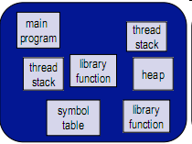
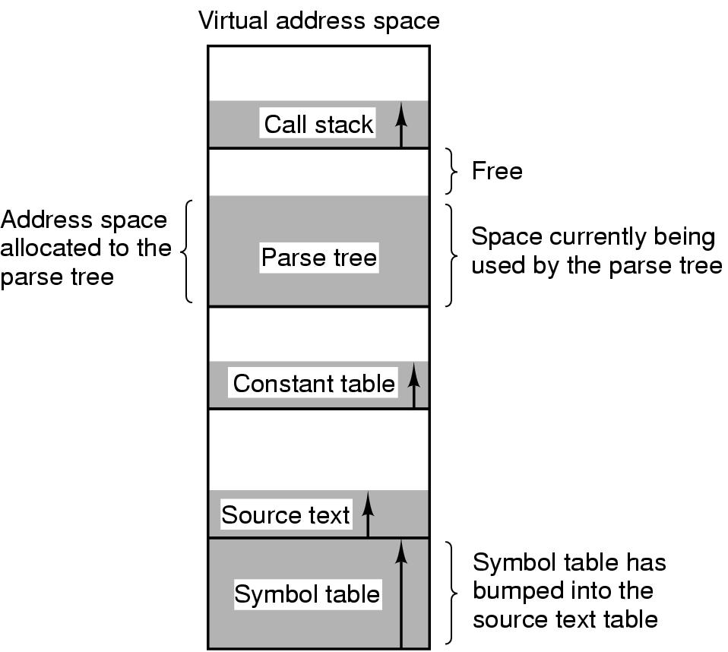
Segmentation
Context
Programmer’s view of memory is not usually as a single linear address space
Programmer cannot predict how large these will be, or how they’ll grow, and doesn’t want to manage where they go in virtual memory
The virtual memory is one-dimensional because the virtual address go from 0 to some maximum address, one address after one another.
The virtual memory gives a process a complete virtual address space to itself

Slide 27
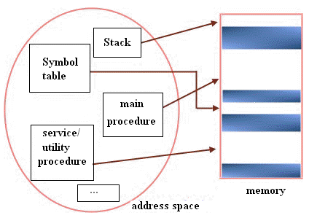
Segmentation
Problem
The processes as compiler has many objects such as executed code, Static/ Heap Data, Stack, constant table … that are located in address space
One of them may grow and shrinks in dynamically or unpredictably
→ It is really needed a way of freeing manage the expanding and contracting space that virtual memory eliminates the worry of organizing the program into overlays
Solution: Using Segmentation
Segmentation provides the mechanism to management memory with many completely independent address spaces and are not fixed size as page
Segmentation maintains multiple separate virtual address spaces per process
The address space is a collection of segments
Segmentation can grow or shrink independently

Slide 28
Segmentation Example
Tanenbaum, Fig. 3-32.

Slide 29
Segmentation
Each Segment
Is a logical entity.
Consists of a linear sequence addresses, from 0 to some maximum
Its length may be anything from 0 to maximum allowed
Different segments may have different length and may change during execution (ex: the stack segment may be increased or decreased)
Constitutes a separate address space, different segments can grow and shrink independently without effecting each other
Might contain a procedure, or a array, or a stack, or a collection of scalar variables, but usually it does not contain a mixture of different types (→ have different kinds of protection)
Facilities sharing procedures or data between several processes (e.g. share library)
The compiler automatically construct segments reflecting the input program
To specify an address in the segmented memory, the program must supply two-part address, a segment number, and an address within the segment <segment-number, offset>

Slide 30
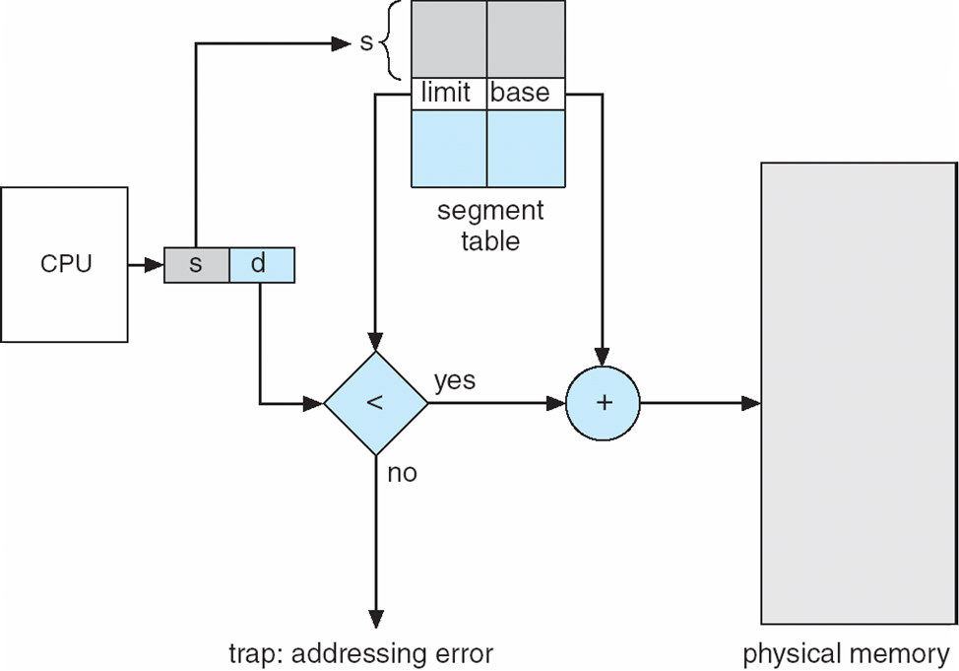
Segmentation Implementation using Hardware
Segment table
Each entry has segment base and segment limit
Segment base contains the starting physical address where the segment resides in memory
Segment limit specifies the length of segment
Segment splits into <segment_number, offset> and using segment_number as index into the segment table
The real address is calculated by adding the offset to segment base

Slide 31
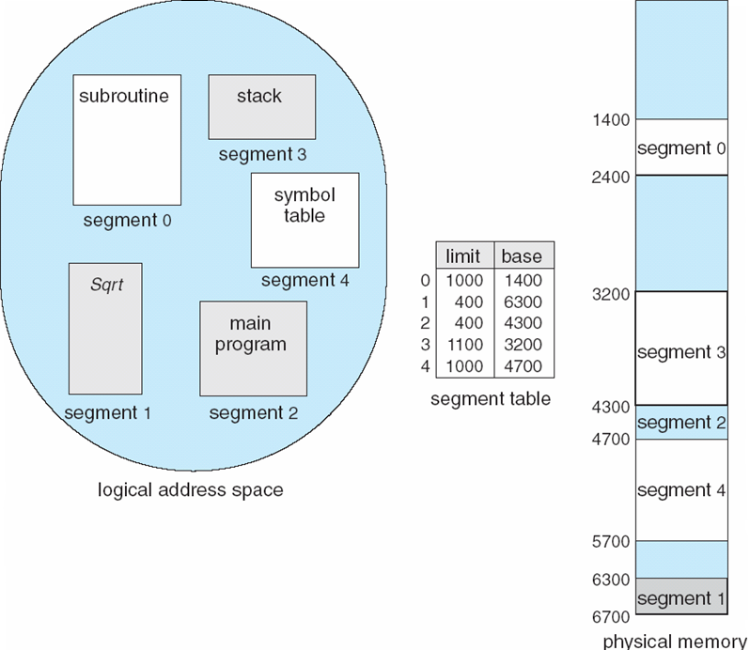
Segmentation Example
Segment 2 begins at 4300 and has 400 bytes size
→ If A byte 53 of segment 2 is referenced, the physical address is 4300 + 53 = 4353
If A byte 1222 of segment 0 is referenced, the trap to the OS is occurs

Slide 32
Segmentation
Advantages
Can grow or shrink independently
Reduce costly because no starting addresses have been modified even if the new version is subsequently modified and recompiled creating the larger or the smaller size than the old one
Each procedure occupies a separate segment, with address 0 as its starting address
When a procedure call to the procedure locating at segment n as (n, 0), no procedures need be changed
Vs. the one dimensional memory, the procedures are packed tightly next to each other, with no address space between them → changing one procedure’s size requires modifying some procedures (that are moved) following the new starting address
Sharing
The entries in the segment table of two different processes point to the same physical location
→ Eliminating the need for many same code or data in every process’s address space
Protection is supported by memory management in modern OS (e.g the code is read only, the limit register on the hardware ….)
Disadvantages: external fragmentation → compacting

Slide 33
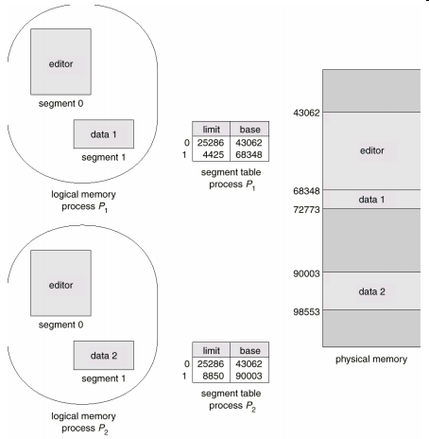
Segmentation Example

Slide 34
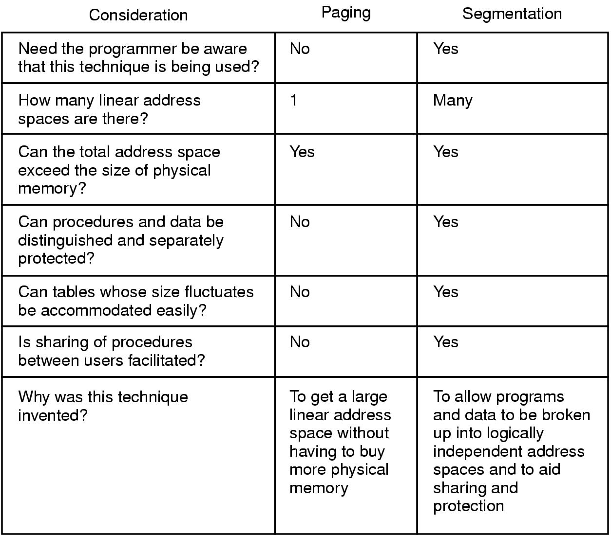
Segmentation **Paging vs. Segmentation
Tanenbaum, Fig. 3-33.

Slide 35
Segmentation Implementation of Pure Segment
Checkerboarding and external fragmentation
Memory will be divided up into a number of chunks, some containing segments and some containing holes (after the system has been running for a while)
Wastes memory in the holes
Can be dealt with by compaction (means that external fragmentation)
Tanenbaum, Fig. 3-34.

Slide 36
Segmentation Segmentation with Paging
Context
Both paging and segmentation have advantages and disadvantages
Some system uses one of them to manage its memory.
However, if the segments are large, it may be inconvenient, or even impossible, to keep them in main memory in their entirety
Solution: using paging the segmentation
Treats each segment as a virtual memory and to page it, combining
The advantages of paging (uniform page size and not having to keep the whole segment in memory if only part of it is being used)
The advantages of segmentation (ease of programming, modularity, protection, sharing)
This strategy is applied on Intel Pentium and MULTICS

Slide 37
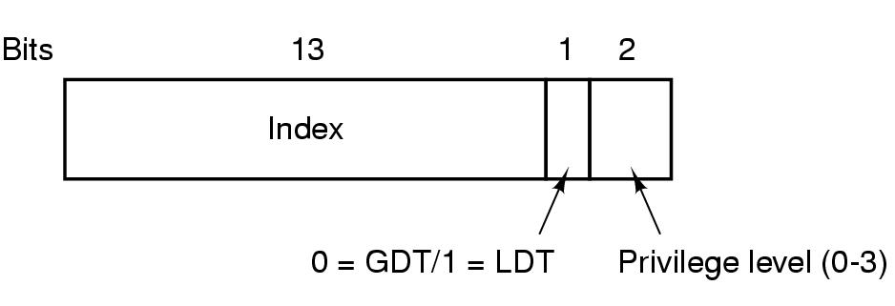
Segmentation Segmentation with Paging: The Intel Pentium
The virtual memory is divided into two partition (8K segment)
Local Descriptor Table (LDT): describes segments local to each program including codes, data, stack …
Global Descriptor Table (GDT): describes system segments including the OS itself
Each entry in the LDT and GDT consists 8 bytes and contains the segment base and segment limit
Each program has its own LDT, but there is a single GDT, shared by all the programs on the computer
The virtual address is a pair of <selector, offset>
The selector is a 16 bit numbers
13 bits specify the LDT or GDT entry number
1 bit tells whether the segment is local or global
2 bits relate to protection with value
The offset is a 32 bit number
Tanenbaum, Fig. 3-39.

Slide 38
Segmentation Segmentation with Paging: The Intel Pentium
The machine has 6 segment registers
Allowing 6 segments to be addressed at any one time by a process
The machine has also 6 microprogram registers (8 byte)
Holding the corresponding descriptors from either the LDT or GDT
Including the segment’s base address, size, and other information
Tanenbaum, Fig. 3-40.

Slide 39
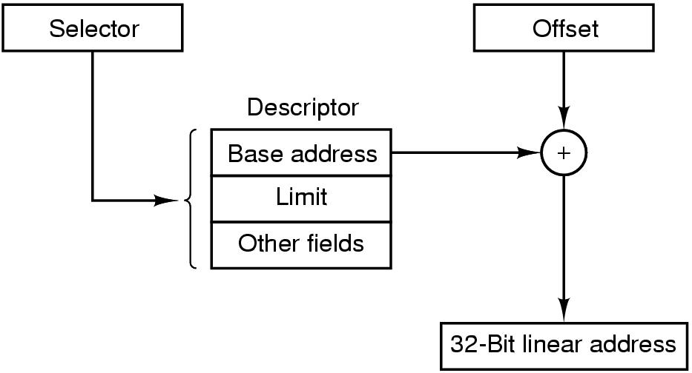
Segmentation Segmentation with Paging: The Intel Pentium
How to convert a (selector, offset) to physical address
The microprogram find descriptor corresponding to selector
The trap occurs if the currently page out or segment does not exist
Then, the hardware uses the Limit field to check if the offset is beyond the end of the segment
If so, the trap occurs
Otherwise, the Pentium adds the 32 bit Base field in descriptor to the offset to form what called a linear address
Tanenbaum, Fig. 3-41.

Slide 40
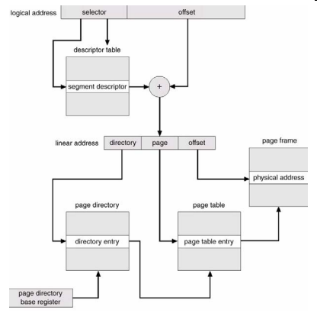
Segmentation Segmentation with Paging: The Intel Pentium
How to convert a (selector, offset) to physical address (cont)
If paging is disable
The linear address is interpreted as the physical address and sent to the memory for the read and write
If paging is enabled (following the multilevel page table)
The linear address is interpreted as a virtual address and mapped onto the physical address using page tables
The linear address divided into three fields
Dir: index into the page directory to locate a pointer to the proper page table
Page: index into the page table to find the physical address of the page frame
Offset: is added to the address of the page frame to get the physical address of the byte or the word needed

Slide 41
Segmentation Segmentation with Paging: The Intel Pentium
The Pentium supports four protection levels (0 – 3)
0: kernel of OS handles I/O, memory management, and other critical matters
1: the system calls handler is present
2: contains library procedures, possibly shared among many running programs (call, read, or not modify)
3: user program
A program restrict itself to using segments at its own level
Attempts to access data at higher level are permitted
Attempts to access data at a lower level are illegal and cause traps
Attempts to call procedures at a different level are allowed, but in carefully controlled way
Tanenbaum, Fig. 3-43.

Slide 42
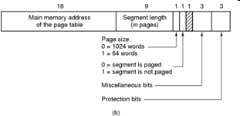
Segmentation Segmentation with Paging: MULTICS
MULTICS (Multiplexed Information and Computing Service) was an extraordinarily influential early time-sharing system.
Each program has a segment table, with one descriptor per segment
The segment table is itself a segment and is paged
A descriptor contains an indication of whether the segment is in main memory or not
If so,
The segment and page table are in memory
The descriptor contains an 18 bit pointer to its page table, 9 bit segment size, the protection bits, and few other items
Tanenbaum, Fig. 3-34.

Slide 43
Segmentation Segmentation with Paging: MULTICS
Each segment is an ordinary virtual address space and is paged
An address consists of two parts
The segment
The address within the segment is divided into two parts
The page number
The offset
In implementation,
The descriptor segment is itself paged has been omitted
A base register is used to locate the descriptor segment’s table/ This register points to the pages of descriptor segment
Tanenbaum, Fig. 3-36.

Slide 44
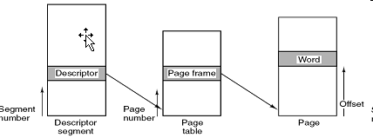
Segmentation Segmentation with Paging: MULTICS
How to convert the <segment, offset> to physical address
The segment number is used to checked if the segment’s table is in memory or not
If so, the segment table is located.
The page number is used to check if the virtual page is mapped (valid)
If so, the page frame is added to the offset to give the physical address
Otherwise, a page fault is triggered.
If not, segment fault occurs.
If there is a protection violation, a fault (trap) occurs.
Tanenbaum, Fig. 3-37.

Slide 45
Segmentation Segmentation with Paging: MULTICS
In reality implementation,
The TLB is used
When an address is presented to the computer, the addressing first checks to see if the virtual address is in the TLB
If so, it gets the page frame number directly from the TLB and forms the actual address of the referenced word without having to look in the descriptor segment or page table
Otherwise,
The descriptor and page tables are referenced to find the page frame address
Then, the TLB is updated to include this page using Aging page replacement

Slide 46
Summary
Design Issues for Paging Systems
Implementation Issues
Segmentation
Q&A

Slide 47
Next Lecture
File System Components in OS
Introduction
Implementation
Management
Optimization
Applying in practices

